Slide 1











Smart E-Health Prediction
Team Guide
Vaheetha Salam
Team Members
Ajmi A
Anagha R

Slide 2
Why This ?
It might have happened so many times that you or someone yours need doctors help immediately, but they are not available due to some reasons or also sometimes it happens that we could not find the correct doctor for the treatment , so to solve this problem we will implement the online Smart Health prediction that will facilitate the patient to get instant guidance on their health issues

Slide 3

INTRODUCTION
The core idea behind the project is to propose a system that allows users to get instant guidance on their health issues . This system allows user to share their symptoms and issues. It then processes user’s symptoms to check for various illnesses that could be associated with it .The system informs the user about the type of disease or disorder it feels user’s symptoms are associated with and also suggest the doctor to whom he or she can contact.

Slide 4
Overview
The main aim of this system is to develop a prediction model that takes the symptoms from the user and predicts the disease he/she is more likely to have.
With the help of Disease Prediction the user will be able to know the probability of the disease with the given symptoms.

Slide 5
Technology Used
HTML,CSS, Bootstrap, Javascript, Jquery
Python(Django),PostgreSQL
Github

Slide 6
Disease Prediction using symptoms by Machine Learning
In this project we use
Naive Bayes Classifier
This algorithm works quickly and can save a lot of time.
Naive Bayes is suitable for solving multi-class prediction problems.
It can perform better than other models and requires much less training data.
This algorithm predict the disease as a result when the user enter the symptoms of diseases.
It provide accuracy. The accuracy of an algorithm is determined by the performance on the given dataset.

Slide 7
Naïve Bayes classifier depends on Bayes Theorem
Equation 1:
P(Disease|symptom1, symptom2, ... ... . , symptom n)
= P(Disease)P(symptom1, ... ... . . , symptom n|Disease)
P(symptom1, symptom2, ... ... ... ... . .Symptom n)
P(Y|X1, ... ... ... . . , Xn) =P(Y)P(X1, ... ... , Xn|Y) P(X1, ... ... . Xn)

Slide 8
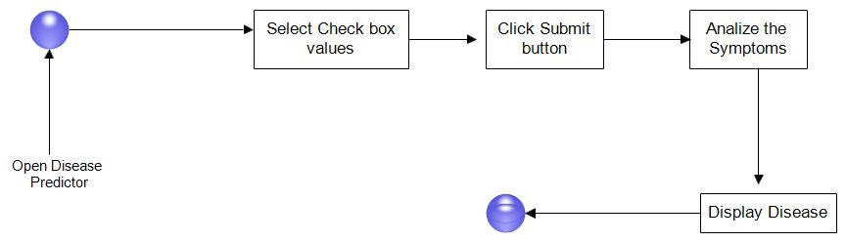
STATE DIAGRAM
It explains different state of the system. First the user opens Disease Predictor. The user selects the symptoms. When finished selecting symptoms the user submits the symptoms. Disease Predictor analyses the symptoms and displays the result.

Slide 9
Sample Data Sets
SYMPTOMS | DISEASE
Runny nose, Cough, Congestion, Headache, Continuos_sneezing, High_fever | Common Cold
high_fever, headache, nausea, vomiting, diarrhoea, muscle_pain, coma | Malaria
abdominal_pain, headache, high_fever, lethargy, diarrhoea, constipation | Typhoid

Slide 10
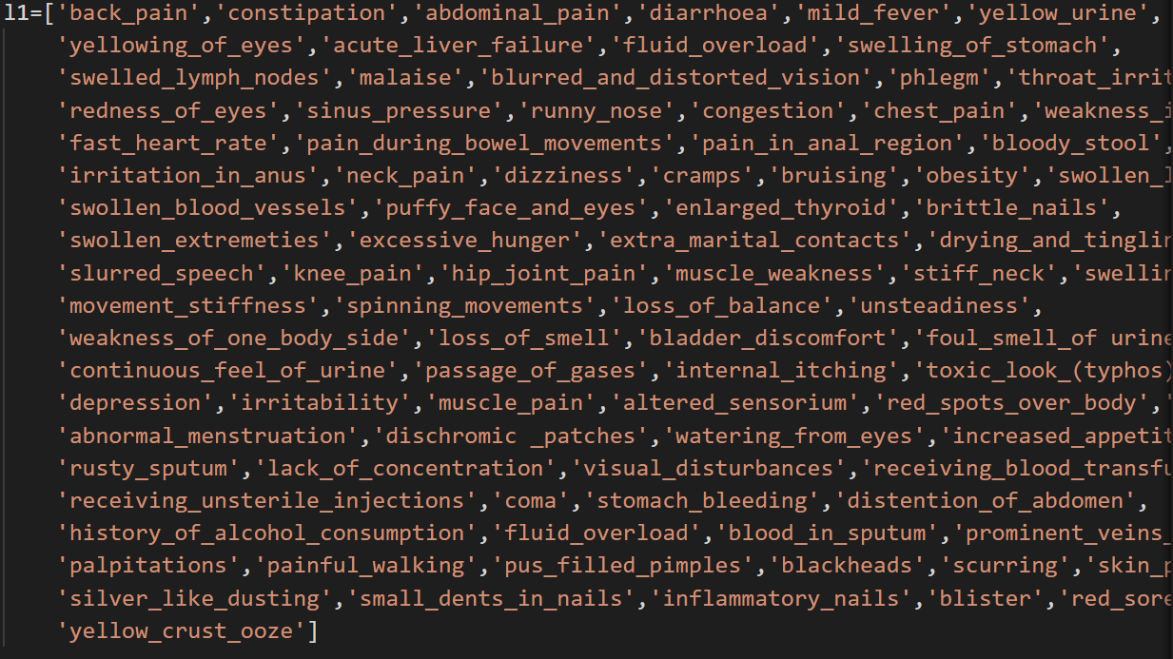
DATASET

Slide 11
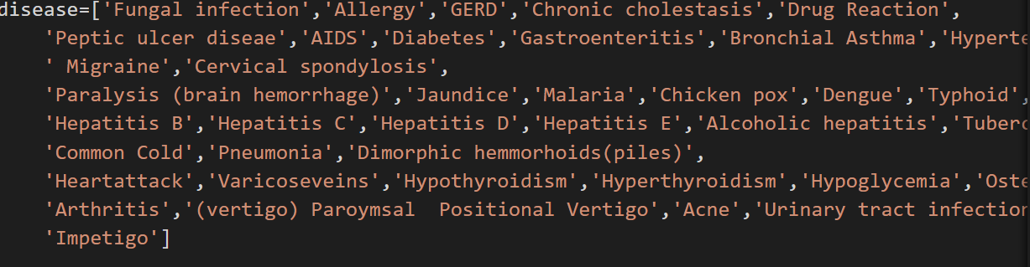

Slide 12
Modules
Admin
Patient
Doctor

Slide 13


Admin Module
Admin Login
Add Doctor
Add Disease
View Doctor
View Disease
View Patient

Slide 14

Patient Module
Patient Login
Patient Registration
Disease Prediction
Consultation

Slide 15
Doctor Module
Doctor Login
Doctor Registration
Consultation History

Slide 16
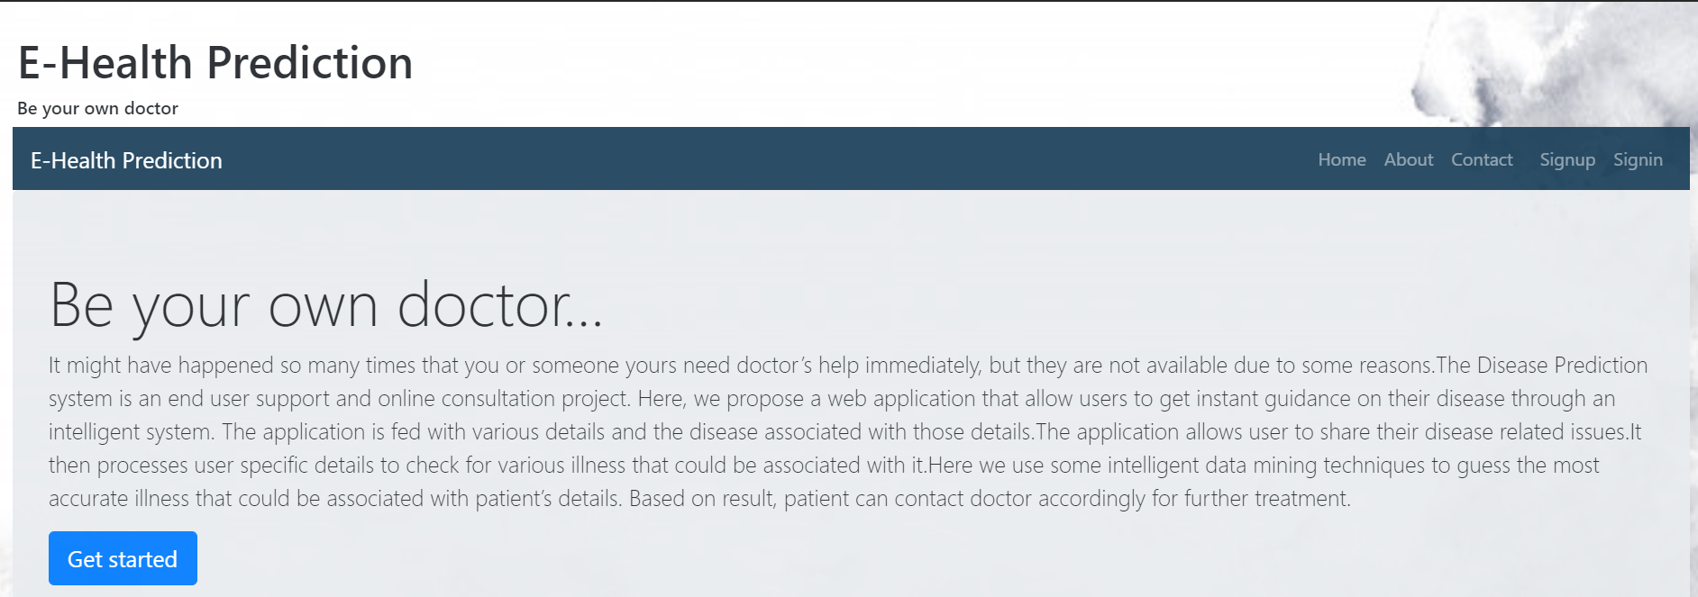
Home Page

Slide 17
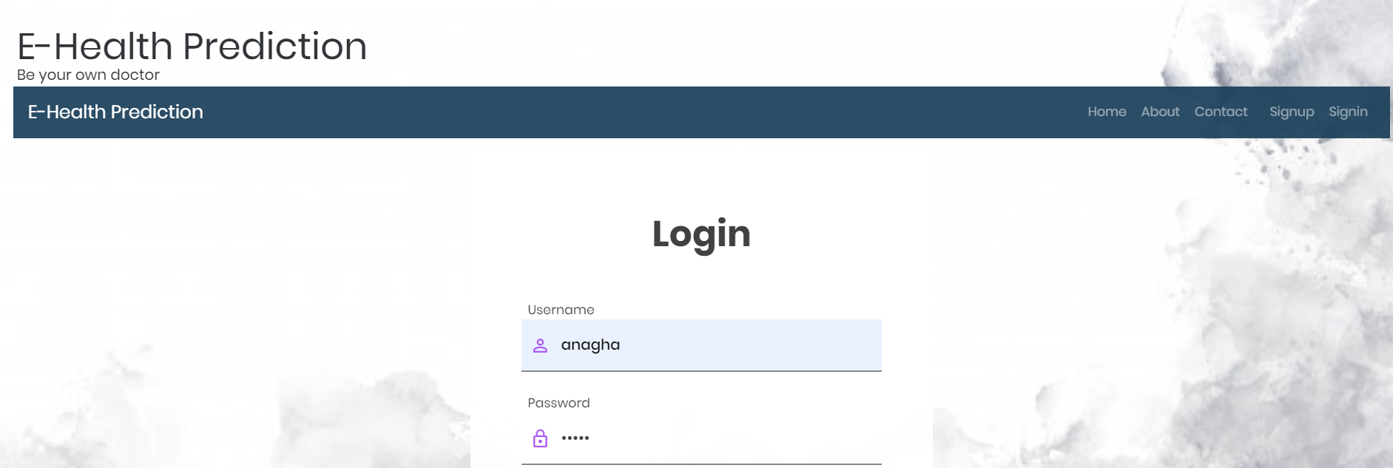
Patient Login

Slide 18
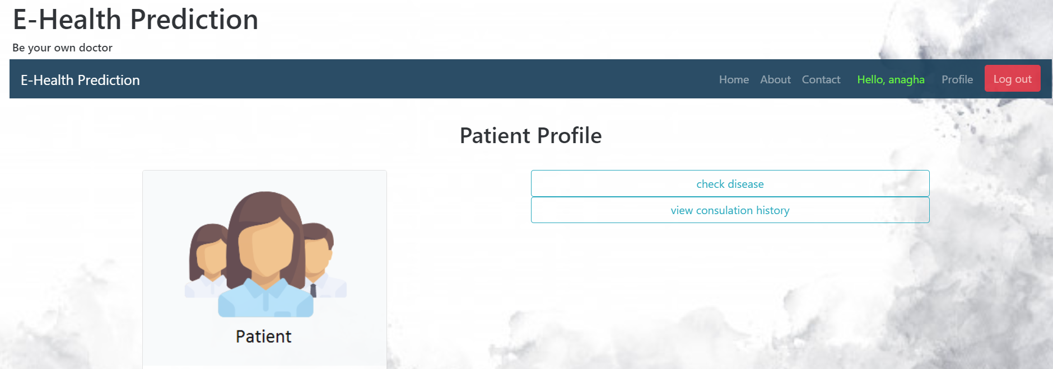

Slide 19
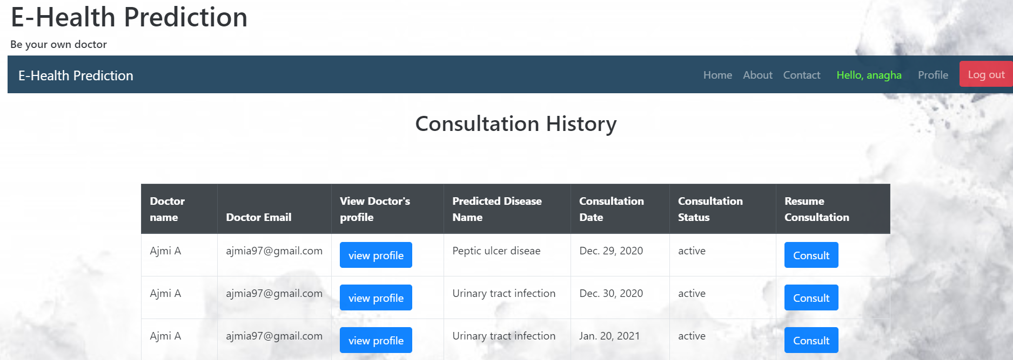

Slide 20
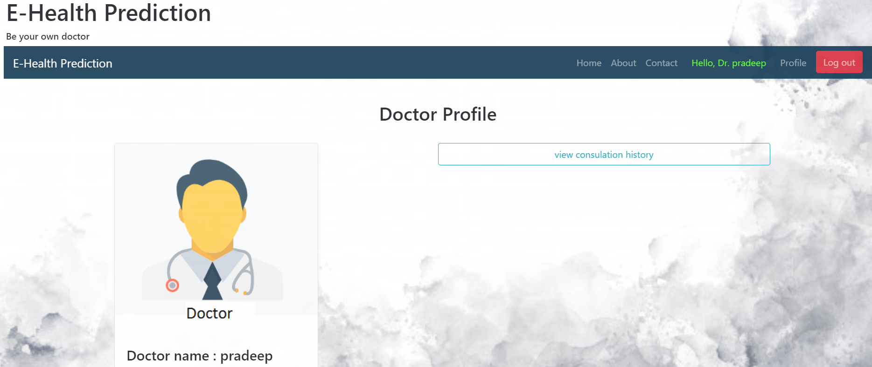
Doctor Login

Slide 21
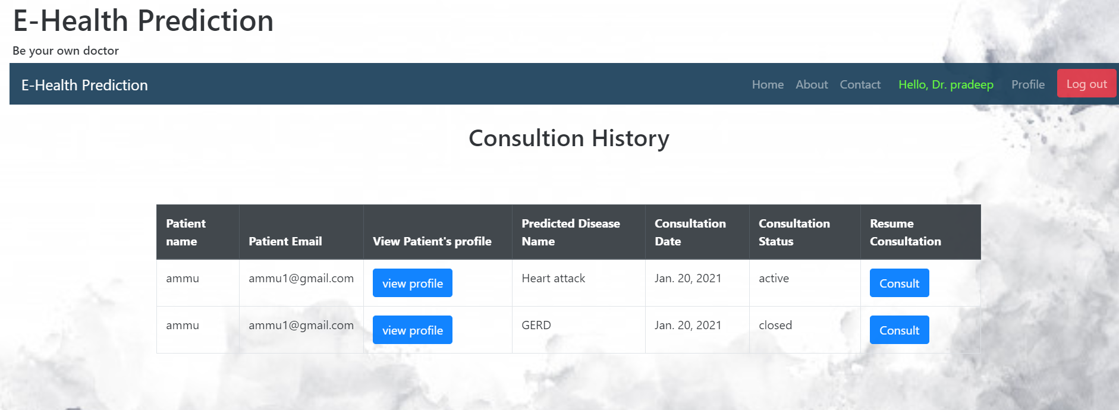

Slide 22
Conclusion
This project aims to predict the disease on the basis of the symptoms. The project is designed in such a way that the system takes symptoms from the user as input and produces output i.e. predict disease. So the system can decrease the rush at hospitals and reduce the workload on medical staff. Average prediction accuracy probability of 55% is obtained. Disease Predictor was successfully implemented using Django framework.

Slide 23
References
[1] Qulan, J.R. 1986. “Induction of Decision Trees”. Mach.Learn. 1,1 (Mar. 1986),81-10
[2] Sayantan Saha, Argha Roy Chowdhuri et,al “Web Based Disease Detection System”,IJERT, ISSN:22780181,Vol.2 Issue 4, April-2013
[3] Shadab Adam et.al “Prediction system for Heart Disease using Naïve Bayes”, International Journal of advanced Computer and Mathematical Sciences, ISSN 2230- 9624, Vol 3,Issue 3,2012,pp 290- 294[Accepted- 12/06/2012].

Slide 24
Thank You

